Slide 1
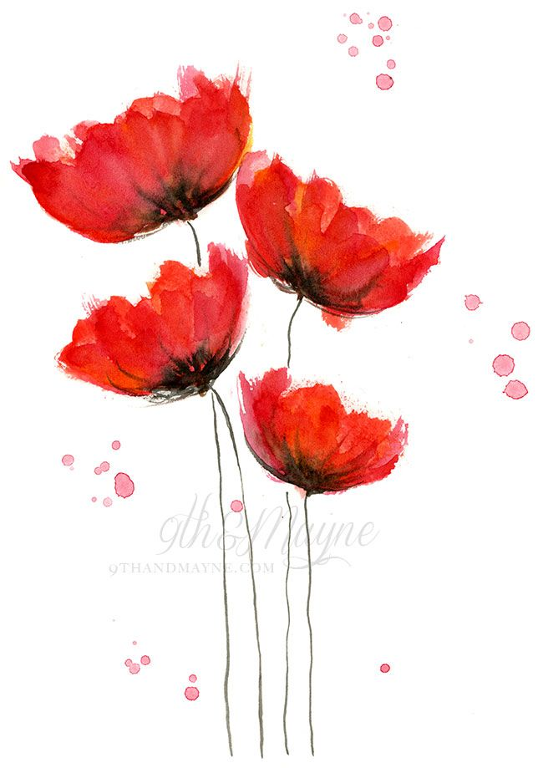
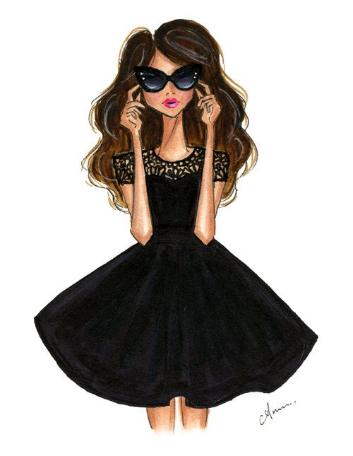
Feminism
By, Kelsey Channer

Slide 2
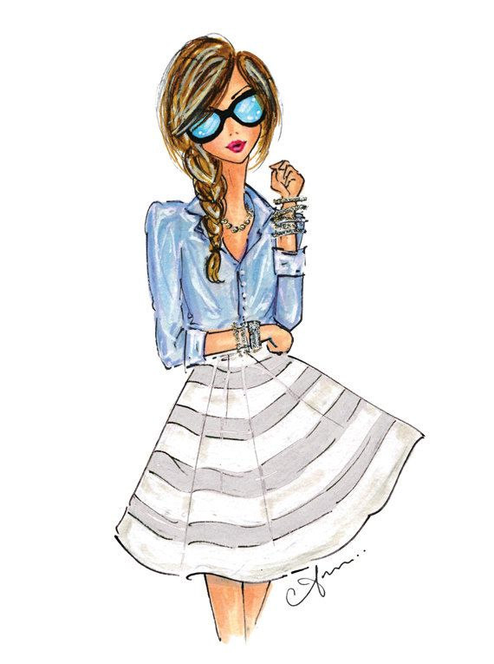
What is Feminism?
Definition: The belief that men and women should have equal rights and opportunities.
  (http://www.merriam-webster.com/dictionary/feminism)
My definition: Feminism isn’t only having equal rights and opportunities as men, but also being treated equal socially.

Slide 3
Hillary Clinton and Feminism
Democratic presidential candidate, Hillary Clinton, has been sufficiently using feminism in her campaigning. Why is Clinton such an advocate for women’s rights? According to www.jacobinmag.com, “sexist attacks that have targeted her…” are why she supports feminism. So the question becomes, why should WE support feminism?

Slide 4
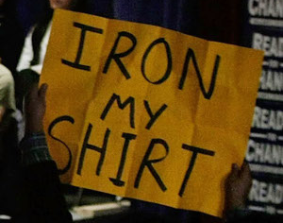
“A protester waves a sign disrupting Clinton’s campaign speech in Salem, New Hampshire on January 7, 2008.” © Joe Raedle/Getty Images

Slide 5
Social Treatment
It’s subtle, but it’s there.
“It's about the fact that I can't walk down the streets without getting hit on. I am so sick and tired of hearing obscenities whenever I walk down the street. What's terrible is that women are so used to this. We're told to take this as a compliment. That it means we're pretty.”
  http://www.huffingtonpost.com/anna-quesse/im-done-being-quiet-about-feminism_b_6941890.html

Slide 6
There has been an outcry from men defending the harassers saying "They were just saying 'hello.'" If it was just an innocent "hello" or "you're beautiful" then it would be fair to say that those same men also extend the same greetings and compliments to others they see on the street including children, elderly women, and OTHER MEN.
  http://www.huffingtonpost.com/dj-kalkutta/your-compliments-are-gros_b_6072678.html

Slide 7
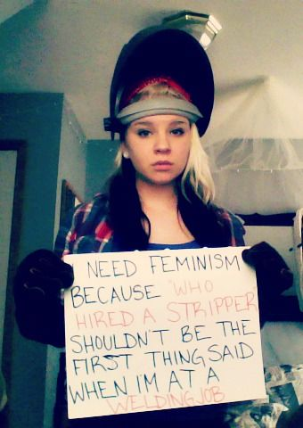
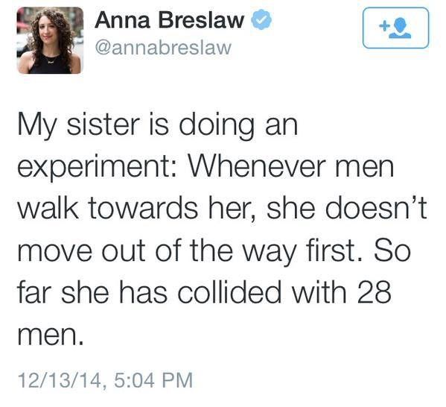

Slide 8
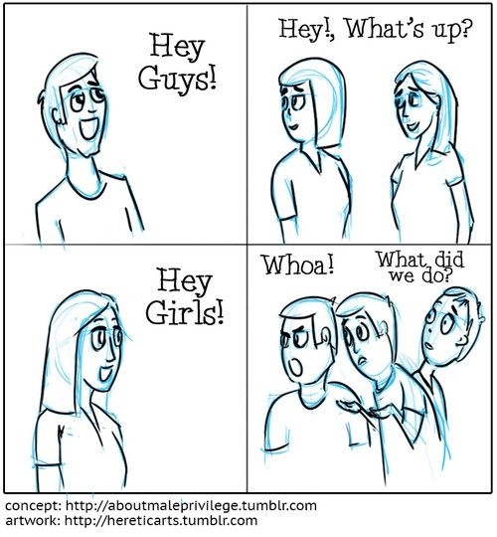
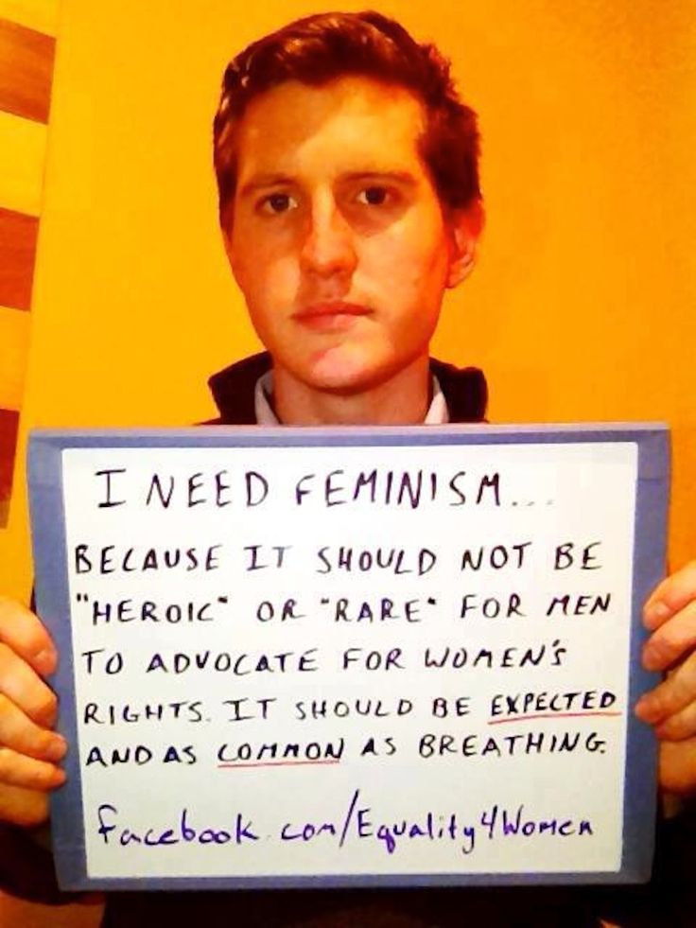

Slide 9
Like a Girl
http://www.cleanvideosearch.com/media/action/yt/watch?v=XjJQBjWYDTs

Slide 10
Conclusion
“Feminism isn’t about making women stronger. Women are already strong. It’s about changing the way the world perceives that strength.” –G.D Anderson

Slide 11
Links
http://www.merriam-webster.com/dictionary/feminism
https://www.jacobinmag.com/2015/03/hillary-clinton-womens-rights-feminism/
http://www.cleanvideosearch.com/media/action/yt/watch?v=XjJQBjWYDTs
http://www.huffingtonpost.com/anna-quesse/im-done-being-quiet-about-feminism_b_6941890.html
http://www.huffingtonpost.com/dj-kalkutta/your-compliments-are-gros_b_6072678.html

